Slide 1
Foundation of Sequential Programs
Adelaiye O.I

Slide 2
Outline
Introduction to Machine Language
Assembly Language, Assemblers
Variables, Memory Allocation
Control Structures
Procedures and Calls
Scopes, Closure, Objects

Slide 3
Outline Contd.
Context-sensitive Analysis
Regular Languages, Scanning
Context-free Language, Parsing
Code Generation
Memory Management

Slide 4
Course Administration
2 hours lecture per week
2 hours lab per week
30% CA
70% Exams
Please be PUNCTUAL
ATTENDANCE is key.
+1

Slide 5
Introduction to Machine Language
Adelaiye O.I.

Slide 6
Objectives
Define Computer Programs
Define Sequential Programs
Define Concurrent Programs
Give examples
Terminologies

Slide 7


Computer Program
Collection of instructions that perform a task.
A major requirement for computers to function.
Instructions are interpreted by a computer and executed.
Examples are: Mozilla Firefox, Microsoft Office, VLC, FIFA 2016 etc.

Slide 8
Computer Program Contd.
The process in creating programs is referred to as programming.
The instructions are created using various writing methods called languages.
Types of languages: machine, assembly, high-level, system, scripting.

Slide 9
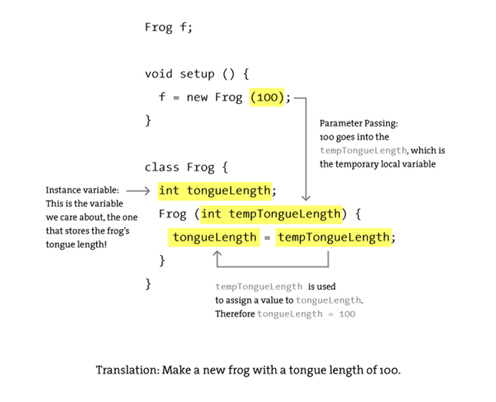

Slide 10
Sequential Programs
The order of the statements determines the order of their execution.
Successive statements must be executed with no overlap to another.
Given the same input data, the same sequence of execution will be followed and the output will be the same.
It is deterministic
The opposite is concurrent programs

Slide 11
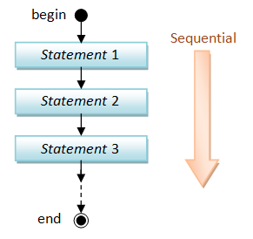

Slide 12
Sequential Programs cont’d
An Example is a calculator
If given the same input provides the same output.

Slide 13
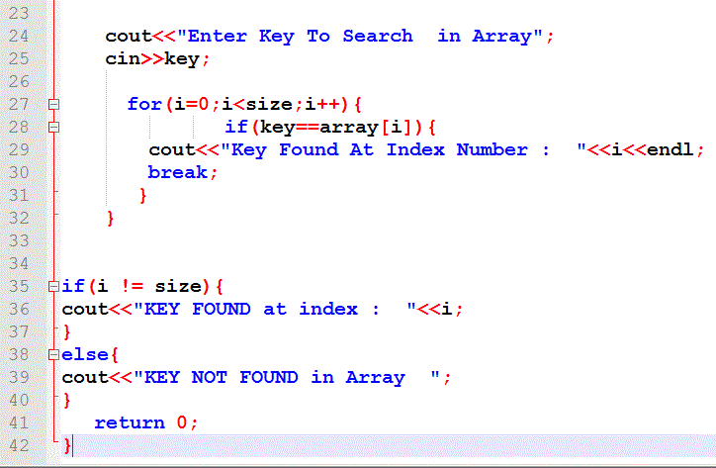

Slide 14
Machine Language
A series of coded instructions
Programming in Binary digits (1’s and 0’s)
Designed to manipulate a memory using a processor and a set of registers.
Eg. A 16 bit Instruction can be
1001011000111010
The 1’s and 0’s represent electrical impulse of an ON and OFF electrical state.

Slide 15
Machine Language Contd.
It’s the basic language of the Computer
Easily understood by machines.
Processing is faster.
Needs no translation.
Although very time consuming and tedious to write programs using machine Language.

Slide 16
Hierarchy of computer languages
Application-Specific Language (Matlab compiler)
High-Level Programming language (C++, Java)
Assembly Language (Machine dependent)
Machine Language (Machine dependent)

Slide 17
Machine Code
Very difficult for humans to read.
An instruction is made up of two parts:
The operator or opcode
The operand
Below the machine code exists the hardware.

Slide 18
Operator or Opcode
They are the first few bits
Specifies the type of operation that needs to be carried out.
For the machine code instruction
00000100011100000000000100000010
The binary code 000001 can be an instruction to store the contents of the accumulator in a given memory address.

Slide 19
Future of Machine Language
With the introduction of 64-bit CPUs (Itanium, Itanium-2, AMD 64, new assembly language instructions have to be added, old ones have to be either redesigned or eliminated. This also puts stress on compiler designers as well as hardware implementation.
Most recent introduction of Intel’s family of dual-core CPUs puts even higher demands on proper hardware and software implementation.
Possibly current 16 and 32-bit instruction set will become obsolete in near future in order to avoid backward compatibility problems and minimize production costs.

